Slide 1

CREDIT CARD
WEEKLY STATUS REPORT

Slide 2
Project Objective :
To Develop a comprehensive credit card weekly dashboard that provides real-time insights into Key Performance Metrices and trends, enabling stakeholders to monitor and analyse credit card operations effectively.

Slide 3
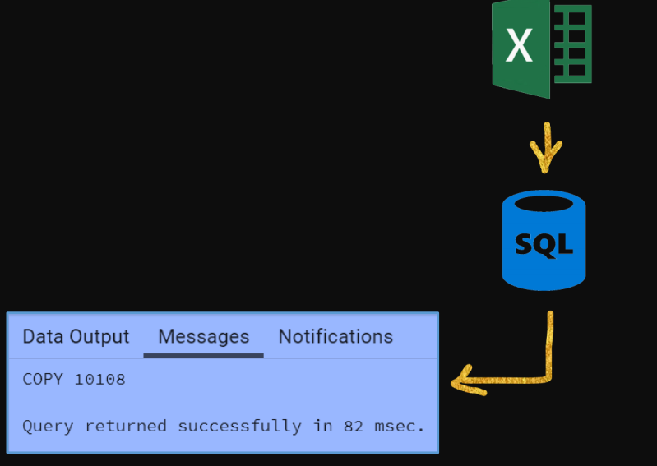
Steps followed :
Import Data to SQL Database:
Prepare csv File
Create table in SQL
Import csv file into SQL

Slide 4
DAX Queries used:
Current_week_Revenue = CALCULATE(
SUM('public cc_detail'[Revenue]),
FILTER(ALL('public cc_detail'),'public cc_detail'[week_num2] = MAX('public cc_detail'[week_num2])))
Prev_week_Revenue = CALCULATE(
SUM('public cc_detail'[Revenue]),
FILTER(ALL('public cc_detail'),'public cc_detail'[week_num2]=MAX('public cc_detail'[week_num2])-1))
AgeGroup = SWITCH( TRUE(),'public cust_detail'[customer_age]<30, "20-30",'public cust_detail'[customer_age]>=30 && 'public cust_detail'[customer_age]<40,"30-40",'public cust_detail'[customer_age]>=40 && 'public cust_detail'[customer_age]<50,"40-50",'public cust_detail'[customer_age]>=50 && 'public cust_detail'[customer_age]<60,"50-60",'public cust_detail'[customer_age]>=60,"60+","unknown")
Income_Group = SWITCH
(TRUE(),'public cust_detail'[income] <35000,"Low",
'public cust_detail'[income] >=35000 && 'public cust_detail'[income]<70000 ,"Med",
'public cust_detail'[income]>=70000, "High")

Slide 5
Quarterly Trends Steady Quarterly Growth: →Revenue gradually increases across Q1 to Q4 (₹163K to ₹173K) — suggests seasonal or behavioural stability in usage. → Minor spikes can be further investigated for seasonal promotions (festivals, holidays, etc.). → Stable Transaction Volumes: Roughly 14M–14.5M transactions per quarter, indicating a loyal and consistently active customer base.

Slide 6
Card Type Performance: Blue Card Dominates Usage → Highest revenue (₹4.71 Cr) and transaction volume (₹3.78 Cr) — it’s the most popular card. → Indicates strong preference for entry/mid-level cards; however, consider upselling Silver/Gold to mature customers. Platinum & Gold Cards Underutilized: → Despite higher reward potential, usage and revenue are relatively low. Insight: Revisit card features, fees, or target premium segments more effectively. Spending & Transaction Behavior: Top Spend Categories: → Bills, Entertainment, and Fuel lead in spending (₹14M, ₹10M, ₹10M respectively). Suggests that utility & lifestyle spending dominates — ideal categories for reward point campaigns. Payment Method Preferences: → Swipe transactions dominate (36M), followed by Chip (17M) and Online (4M). Indicates room for improvement in digital payment adoption. Campaigns promoting secure online payments or exclusive online offers can increase digital usage.

Slide 7
Strategic Recommendations: Upsell Opportunities → Target high-income and well-educated customers (businessmen, graduates, age 30–50) with Gold/Platinum upgrades and premium features. Cross-Sell Insights: → Focus on travel & grocery segments for co-branded card launches or cashback offers.. Spending & Transaction Behavior: Digital Push Strategy: → Promote online and chip-based usage through secure payment awareness, app integration, and reward programs.

Slide 8
THANK YOU

